Slide 1
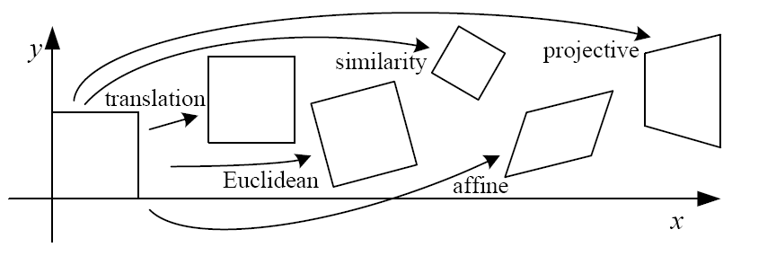
Geometric transformation

Slide 2
References
http://szeliski.org/Book/
http://www.cs.cornell.edu/courses/cs5670/2019sp/lectures/lectures.html
http://www.cs.cmu.edu/~16385/

Slide 3
contents
2D->2D transformations
3D->3D transformations
3D->2D transformations (3D projections)
Perspective projection
Orthographic projection

Slide 4
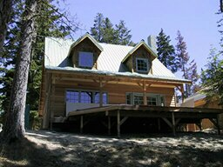
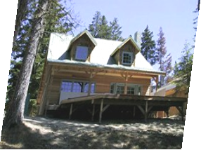
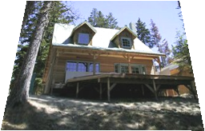
Objective
Being able to do all of the below transformations with matrix manipulation:
Why matrix manipulation?
translation
rotation
scale
shear
affine
projective

Slide 5
Objective
Being able to do all of the below transformations with matrix manipulation:
Why matrix manipulation? Because then we can easily concatenate transformations (for example translation and then rotation).
translation
rotation
scale
shear
affine
projective

Slide 6
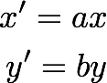

2D planar transformations

Slide 7
scale
How?
Scale

Slide 8
scale
Scale

Slide 9
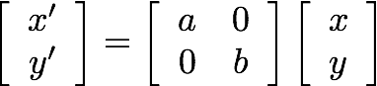
scale
matrix representation of scaling:
scaling matrix S
Scale

Slide 10
Shear
How?
Shear

Slide 11
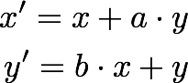
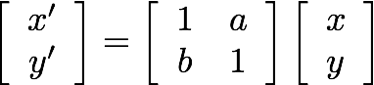
Shear
or in matrix form:
Shear

Slide 12
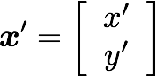
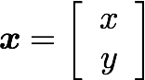



Rotation
How?
rotation around the origin
$$r$$
$$r$$
$$φ$$

Slide 13
Rotation
Polar coordinates…
x = r cos (φ)
y = r sin (φ)
x’ = r cos (φ + θ)
y’ = r sin (φ + θ)
Trigonometric Identity…
x’ = r cos(φ) cos(θ) – r sin(φ) sin(θ)
y’ = r sin(φ) cos(θ) + r cos(φ) sin(θ)
Substitute…
x’ = x cos(θ) - y sin(θ)
y’ = x sin(θ) + y cos(θ)
rotation around the origin
$$r$$
$$r$$
$$φ$$

Slide 14
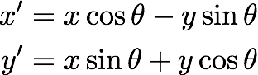
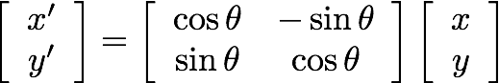
Rotation
or in matrix form:
rotation around the origin

Slide 15
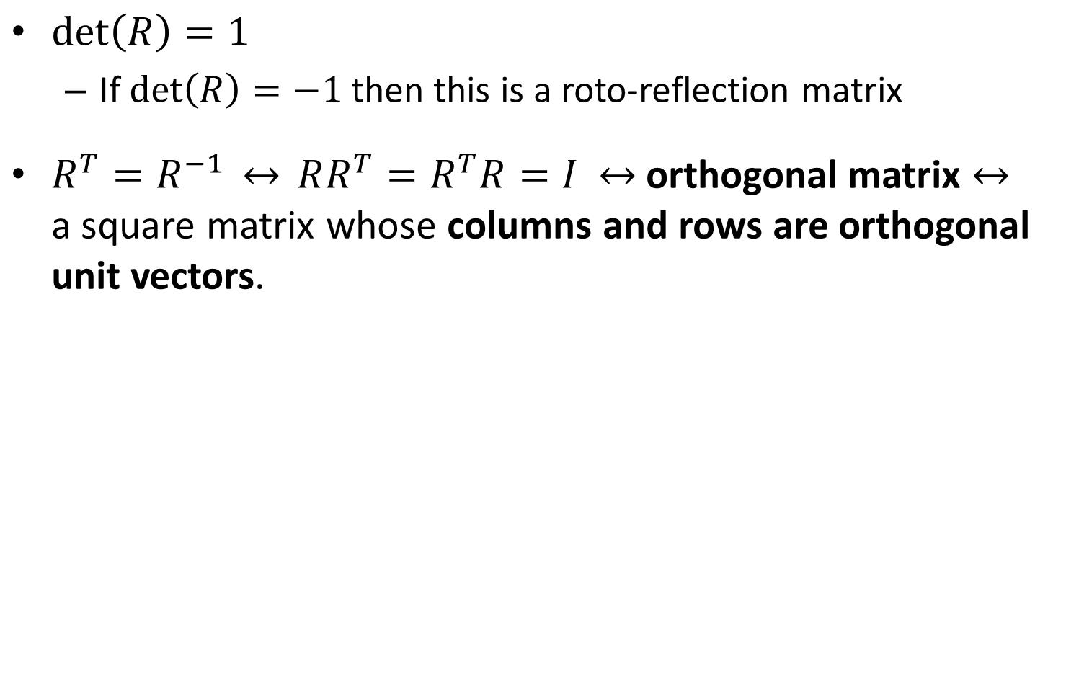
Important rotation matrix features
$\det\left(R\right)=1$
If $\det\left(R\right)=−1$ then this is a roto-reflection matrix
$R^{T}=R^{−1} \underset{↔}{} RR^{T}=R^{T}R=I$ orthogonal matrix a square matrix whose columns and rows are orthogonal unit vectors.

Slide 16
Concatenation
How do we do concatenation of two or more transformations?
Notes:
\\
\begin{bmatrix}x'
\\ y'
\end{bmatrix}
=
\begin{bmatrix}a & 0
\\ 0 & b
\end{bmatrix}
\begin{bmatrix}x
\\ y
\end{bmatrix}
\textrm{and then}
\begin{bmatrix}x''
\\ y''
\end{bmatrix}
=
\begin{bmatrix}cos\theta & -sin\theta
\\ sin\theta & cos\theta
\end{bmatrix}
\begin{bmatrix}x'
\\ y'
\end{bmatrix}
\\
\\
\mapsto
\\
\\
\begin{bmatrix}x''
\\ y''
\end{bmatrix}
=
\begin{bmatrix}cos\theta & -sin\theta
\\ sin\theta & cos\theta
\end{bmatrix}
\begin{bmatrix}a & 0
\\ 0 & b
\end{bmatrix}
\begin{bmatrix}x
\\ y
\end{bmatrix}
=
\begin{bmatrix}acos\theta & -sin\theta
\\ sin\theta & bcos\theta
\end{bmatrix}
\begin{bmatrix}x
\\ y
\end{bmatrix}

Slide 17
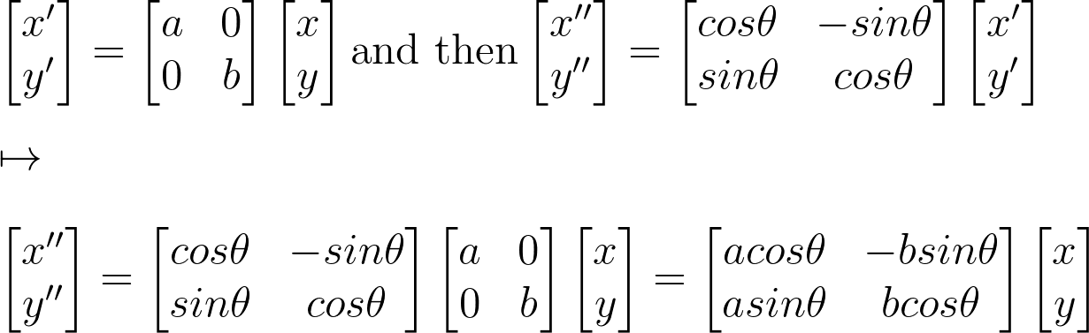
Concatenation
How do we do concatenation of two or more transformations?
Easy with matrix multiplication!
Notes:
\\
\begin{bmatrix}x'
\\ y'
\end{bmatrix}
=
\begin{bmatrix}a & 0
\\ 0 & b
\end{bmatrix}
\begin{bmatrix}x
\\ y
\end{bmatrix}
\textrm{and then}
\begin{bmatrix}x''
\\ y''
\end{bmatrix}
=
\begin{bmatrix}cos\theta & -sin\theta
\\ sin\theta & cos\theta
\end{bmatrix}
\begin{bmatrix}x'
\\ y'
\end{bmatrix}
\\
\\
\mapsto
\\
\\
\begin{bmatrix}x''
\\ y''
\end{bmatrix}
=
\begin{bmatrix}cos\theta & -sin\theta
\\ sin\theta & cos\theta
\end{bmatrix}
\begin{bmatrix}a & 0
\\ 0 & b
\end{bmatrix}
\begin{bmatrix}x
\\ y
\end{bmatrix}
=
\begin{bmatrix}acos\theta & -bsin\theta
\\ asin\theta & bcos\theta
\end{bmatrix}
\begin{bmatrix}x
\\ y
\end{bmatrix}

Slide 18
Translation
How?

Slide 19
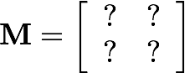
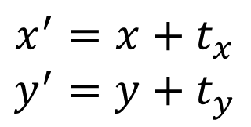
Translation
$$x^{′}=x+t_{x}$$
$$y^{′}=y+t_{y}$$
What about matrix representation?

Slide 20
Translation
$$x^{′}=x+t_{x}$$
$$y^{′}=y+t_{y}$$
What about matrix representation?
Not possible.

Slide 21
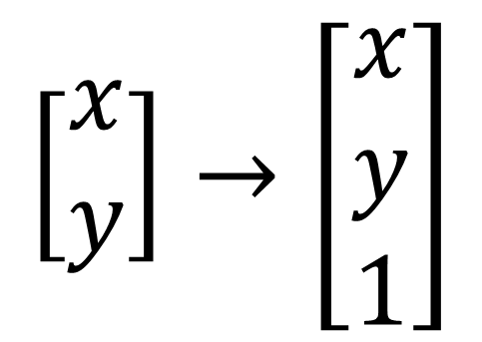
Homogeneous coordinates
Homogeneous coordinates represent 2D point with a 3D vector.
heterogeneous coordinates
homogeneous coordinates
$$\left[\begin{matrix}x \\ y\end{matrix}\right]→\left[\begin{matrix}x \\ y \\ 1\end{matrix}\right]$$

Slide 22
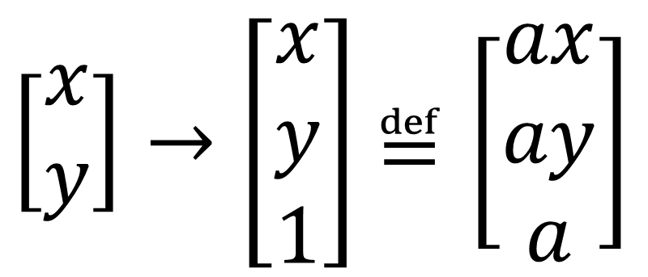
Homogeneous coordinates
Homogeneous coordinates represent 2D point with a 3D vector.
Homogeneous coordinates are only defined up to scale.
heterogeneous coordinates
homogeneous coordinates
$\left[\begin{matrix}x \\ y\end{matrix}\right]→\left[\begin{matrix}x \\ y \\ 1\end{matrix}\right]$ $≝\left[\begin{matrix}ax \\ ay \\ a\end{matrix}\right]$

Slide 23
Translation
How do we do it now?
$$x^{′}=x+t_{x}$$
$$y^{′}=y+t_{y}$$

Slide 24
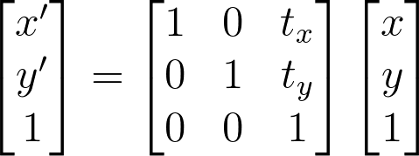
Translation
$$x^{′}=x+t_{x}$$
$$y^{′}=y+t_{y}$$
Notes:
\\
\begin{bmatrix}x'
\\ y'
\\1
\end{bmatrix}
=
\begin{bmatrix}1 & 0 & t_x
\\ 0 & 1 & t_y
\\ 0 & 0 & 1
\end{bmatrix}
\begin{bmatrix}x
\\ y
\\1
\end{bmatrix}

Slide 25
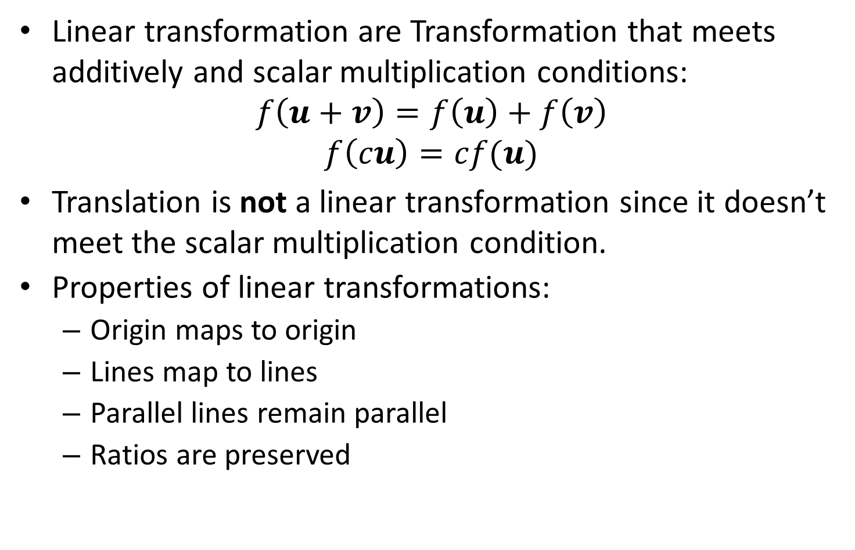
Side note: linear transformation
Linear transformation are Transformation that meets additively and scalar multiplication conditions:
$$f\left(u+v\right)=f\left(u\right)+f\left(v\right)$$
$$f\left(cu\right)=cf(u)$$
Translation is not a linear transformation since it doesn’t meet the scalar multiplication condition.
Properties of linear transformations:
Origin maps to origin
Lines map to lines
Parallel lines remain parallel
Ratios are preserved

Slide 26
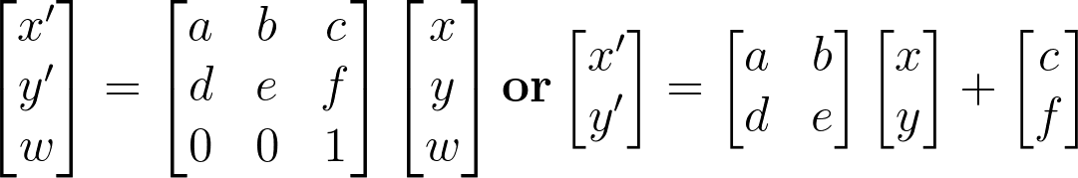
Affine Transformations
Affine transformations are combinations of linear transformations and translations
Properties of affine transformations:
Origin maps to origin
Lines map to lines
Parallel lines remain parallel
Ratios are preserved
Notes:
\\
\begin{bmatrix}x'
\\ y'
\\w
\end{bmatrix}
=
\begin{bmatrix}a & b&c
\\ d & e&f
\\0&0&1
\end{bmatrix}
\begin{bmatrix}x
\\ y
\\w
\end{bmatrix}
\mathrm{\mathbf{or}}
\begin{bmatrix}x'
\\ y'
\end{bmatrix}
=
\begin{bmatrix}a & b
\\ d & e
\end{bmatrix}
\begin{bmatrix}x
\\ y
\end{bmatrix}
+
\begin{bmatrix}c
\\ f
\end{bmatrix}

Slide 27
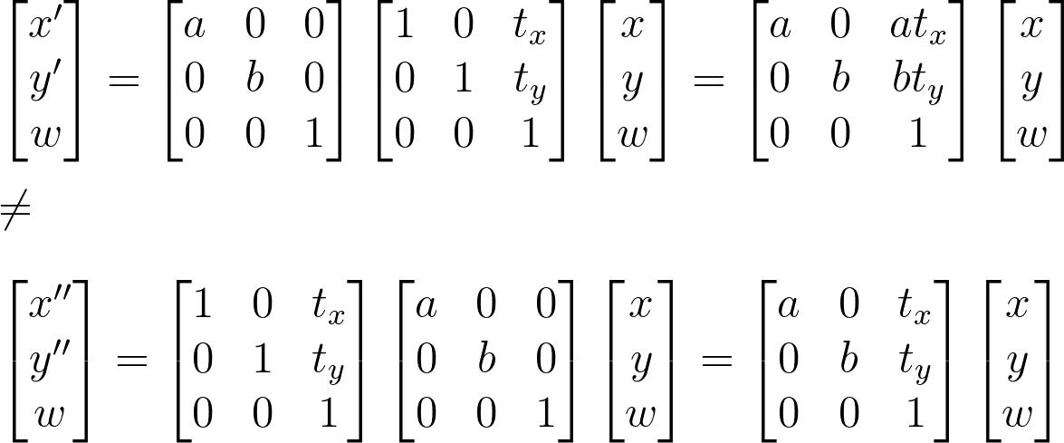
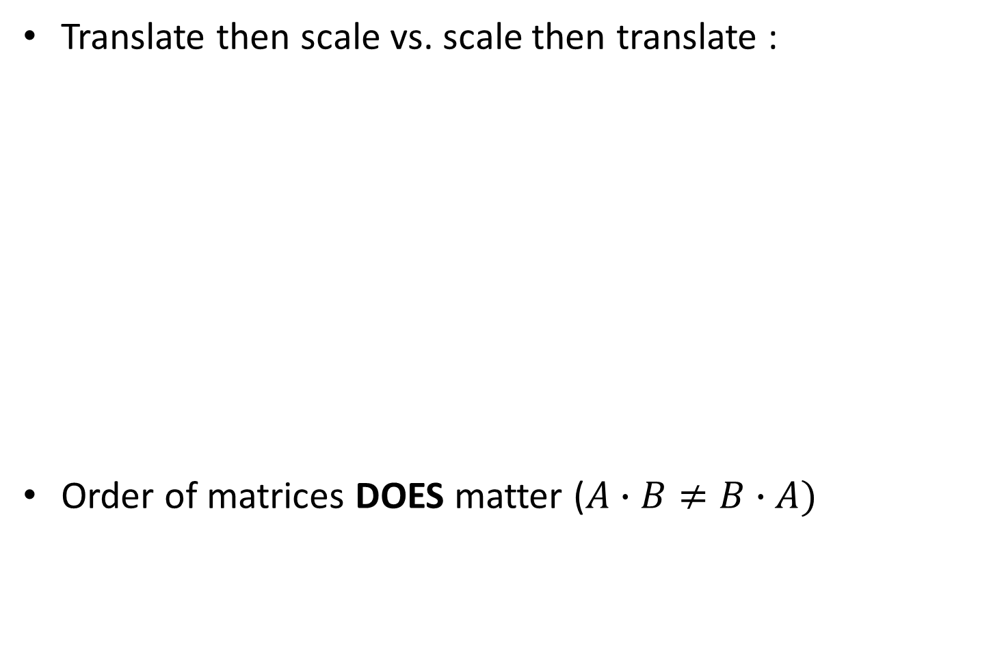
Affine transformation: example
Translate then scale vs. scale then translate :
Order of matrices DOES matter ($A∙B≠B∙A)$
Notes:
\\
\begin{bmatrix}x'
\\ y'
\\w
\end{bmatrix}
=
\begin{bmatrix}a & 0&0
\\ 0 & b&0
\\0&0&1
\end{bmatrix}
\begin{bmatrix}1 & 0&t_x
\\ 0 & 1&t_y
\\0&0&1
\end{bmatrix}
\begin{bmatrix}x
\\ y
\\w
\end{bmatrix}
=
\begin{bmatrix}a & 0 &at_x
\\ 0 & b & bt_y
\\0&0&1
\end{bmatrix}
\begin{bmatrix}x
\\ y
\\w
\end{bmatrix}
\\\\
\neq
\\\\
\begin{bmatrix}x''
\\ y''
\\w
\end{bmatrix}
=
\begin{bmatrix}1 & 0&t_x
\\ 0 & 1&t_y
\\0&0&1
\end{bmatrix}
\begin{bmatrix}a & 0&0
\\ 0 & b&0
\\0&0&1
\end{bmatrix}
\begin{bmatrix}x
\\ y
\\w
\end{bmatrix}
=
\begin{bmatrix}a & 0 &t_x
\\ 0 & b & t_y
\\0&0&1
\end{bmatrix}
\begin{bmatrix}x
\\ y
\\w
\end{bmatrix}

Slide 28
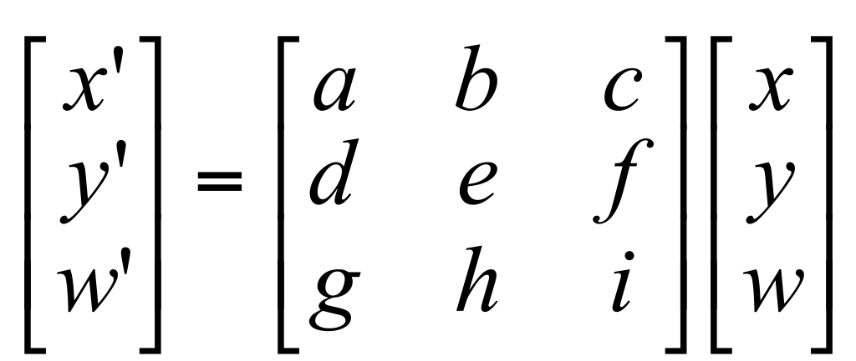
Projective transformation
Also known as homography or homographic transformation.
A generalization of affine transformation.
Properties of projective transformations:
Origin maps to origin
Lines map to lines
Parallel lines remain parallel
Ratios are preserved

Slide 29
Projective transformation
How many DOFs do we have here?

Slide 30
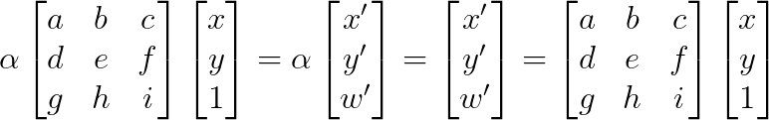
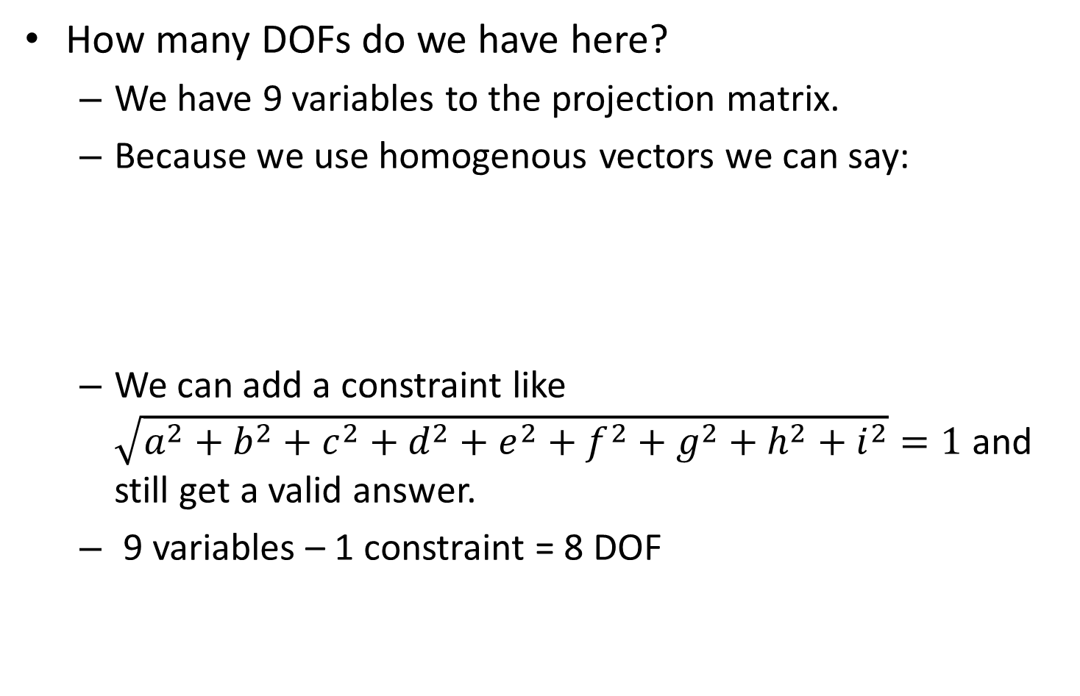
Projective transformation
How many DOFs do we have here?
We have 9 variables to the projection matrix.
Because we use homogenous vectors we can say:
We can add a constraint like $\sqrt{a^{2}+b^{2}+c^{2}+d^{2}+e^{2}+f^{2}+g^{2}+h^{2}+i^{2}}=1$ and still get a valid answer.
9 variables – 1 constraint = 8 DOF
Notes:
\alpha \begin{bmatrix}
a &b &c \\
d& e &f \\
g& h & i
\end{bmatrix}
\begin{bmatrix}
x \\
y \\
1
\end{bmatrix}
=
\alpha \begin{bmatrix}
x' \\
y' \\
w'
\end{bmatrix}
=
\begin{bmatrix}
x' \\
y' \\
w'
\end{bmatrix}
=
\begin{bmatrix}
a &b &c \\
d& e &f \\
g& h & i
\end{bmatrix}
\begin{bmatrix}
x \\
y \\
1
\end{bmatrix}

Slide 31
contents
2D->2D transformations
3D->3D transformations
3D->2D transformations (3D projections)
Perspective projection
Orthographic projection

Slide 32
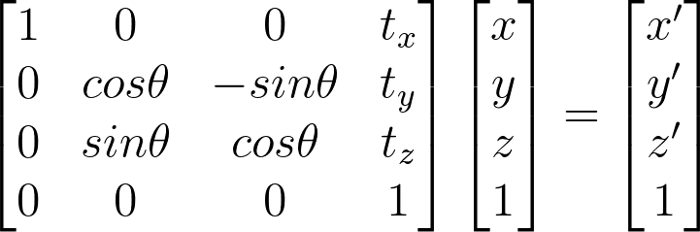
3D->3D transformations
Exactly the same as 2D->2D transformations from earlier, just with 3D.
What do we see here?
Notes:
\begin{bmatrix}1&0&0&t_x
\\0&cos\theta & -sin\theta&t_y
\\0& sin\theta & cos\theta&t_z
\\0&0&0&1
\end{bmatrix}
\begin{bmatrix}x
\\ y
\\z
\\1
\end{bmatrix}
=
\begin{bmatrix}
x'
\\y'
\\z'
\\1
\end{bmatrix}

Slide 33
3D->3D transformations
Exactly the same as 2D->2D transformations from earlier, just with 3D.
What do we see here?
Rotation around x axis and then translation
Notes:
\begin{bmatrix}1&0&0&t_x
\\0&cos\theta & -sin\theta&t_y
\\0& sin\theta & cos\theta&t_z
\\0&0&0&1
\end{bmatrix}
\begin{bmatrix}x
\\ y
\\z
\\1
\end{bmatrix}
=
\begin{bmatrix}
x'
\\y'
\\z'
\\1
\end{bmatrix}

Slide 34
contents
2D->2D transformations
3D->3D transformations
3D->2D transformations (3D projections)
Perspective projection
Orthographic projection

Slide 35
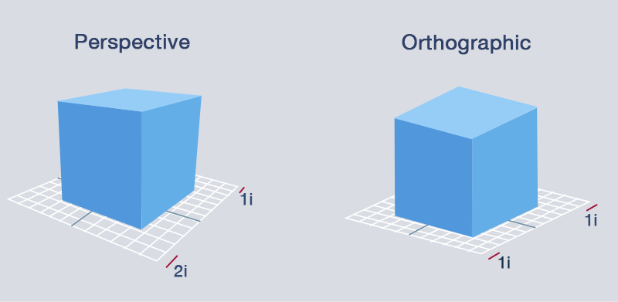
3D projection
3D projection is any method of mapping three-dimensional points to a two-dimensional plane.
Two types of projections are orthographic and perspective.

Slide 36
Perspective- definition
the art of drawing solid objects on a two-dimensional surface so as to give the right impression of their height, width, depth, and position in relation to each other when viewed from a particular point.
a particular attitude toward or way of regarding something; a point of view.

Slide 37
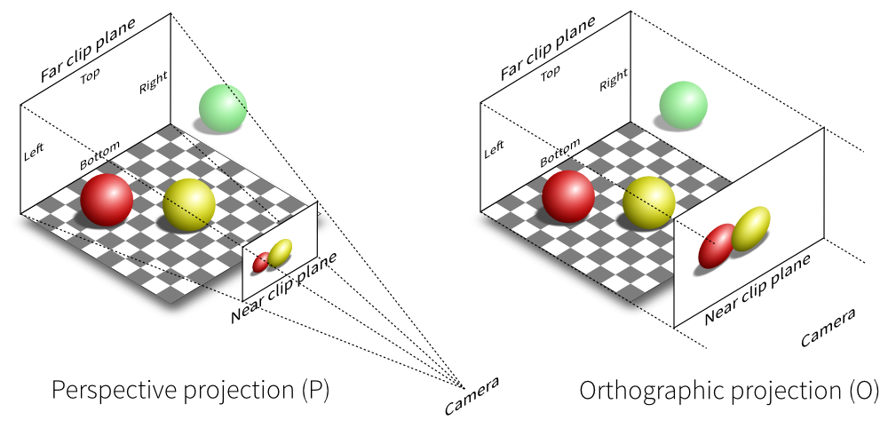
Perspective projection
Perspective projection is the kind of projection we get from a regular image of a regular (pinhole) camera.

Slide 38


perspective manipulation

Slide 39
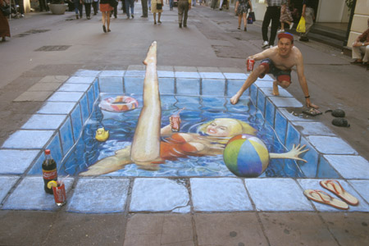
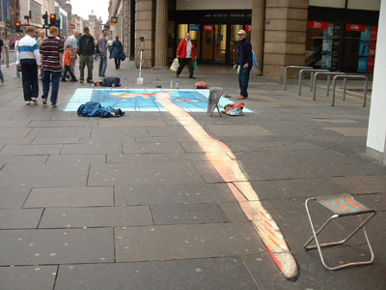
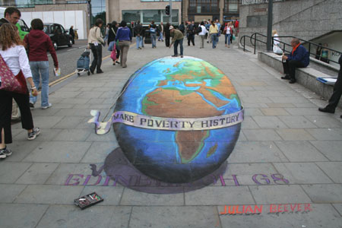
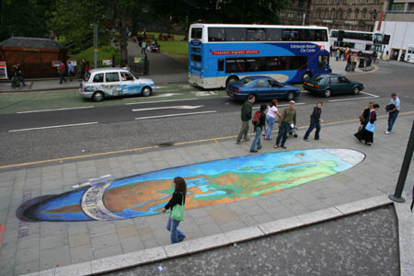
Street art- perspective manipulation

Slide 40
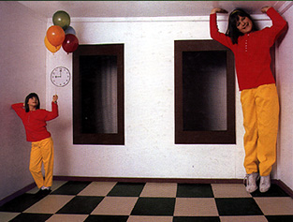
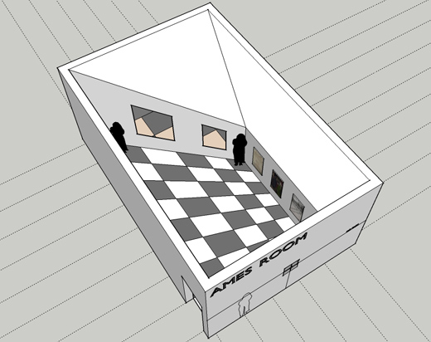
perspective manipulation- Ames Room

Slide 41
Image plane
When dealing with imaged 3D scenes, we tend to use the image plane rather than the sensor plane which is flipped.
real-world object
image plane
sensor plane
focal
length f
focal
length f

Slide 42
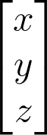

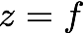
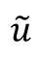
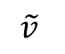

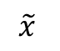
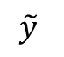
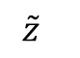
Perspective projection
Perspective projection (also known as perspective transformation) is a linear projection where three dimensional objects are projected on the image plane.
$$\tilde{y}$$
image plane
$$\tilde{x}$$
$$\tilde{v}$$
$$\tilde{u}$$
$$\tilde{z}$$
$$O_{camera}$$
principal axis
Notes:
\begin{bmatrix}x
\\ y
\\ z
\end{bmatrix}
\begin{bmatrix}u
\\ v
\end{bmatrix}

Slide 43
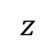
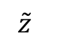
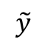
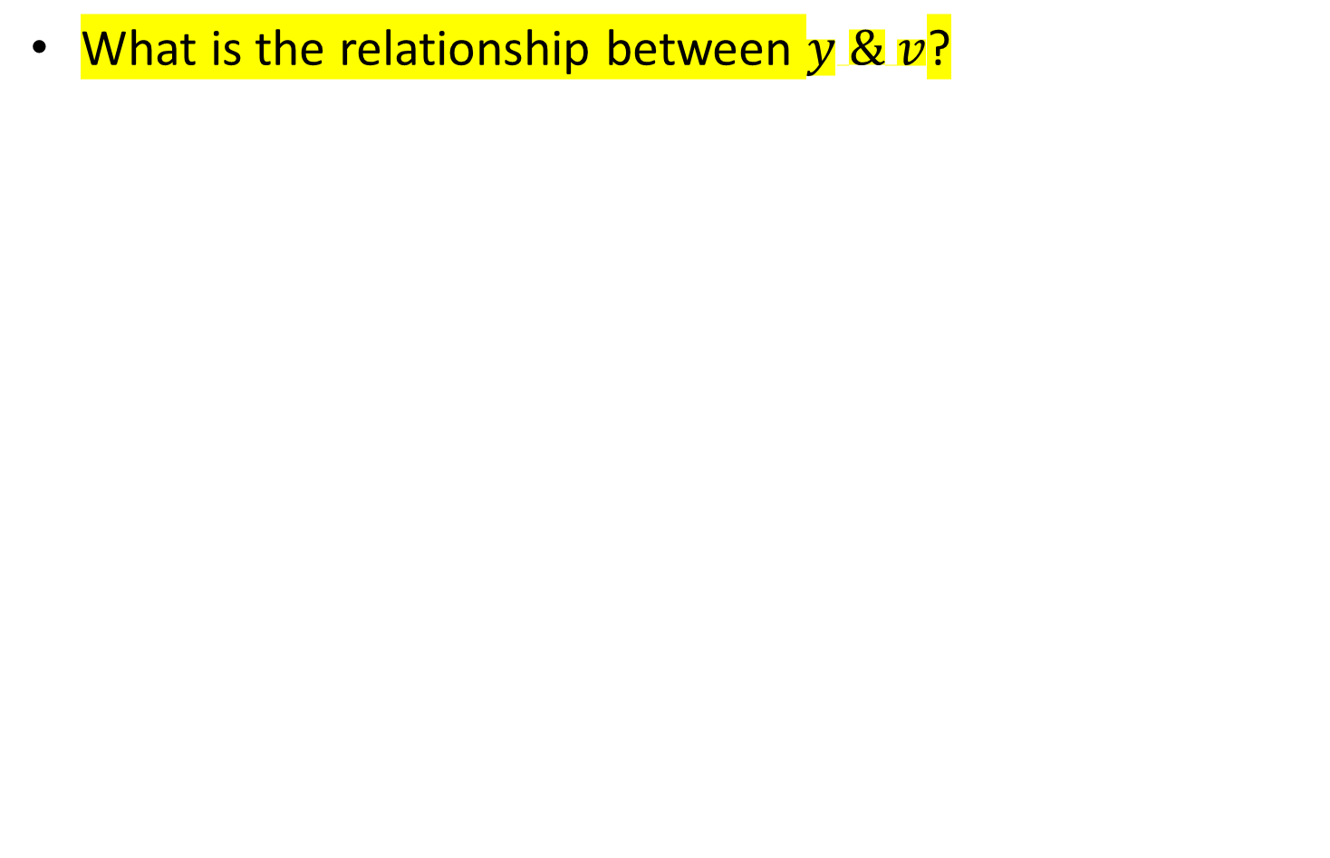
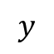
Perspective projection
What is the relationship between $y \& v$?
$$\tilde{y}$$
image plane
$$y$$
$$\tilde{z}$$
$$z$$

Slide 44
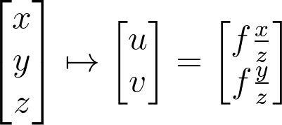
Perspective projection
Using triangle proportions (Thales’ theorem) we can easily conclude that:
$$\tilde{y}$$
image plane
$$y$$
$$\tilde{z}$$
$$z$$
Notes:
\begin{bmatrix}x
\\ y
\\ z
\end{bmatrix}
\mapsto
\begin{bmatrix}u
\\ v
\end{bmatrix}
=
\begin{bmatrix}f\frac{x}{z}
\\ f\frac{y}{z}
\end{bmatrix}

Slide 45
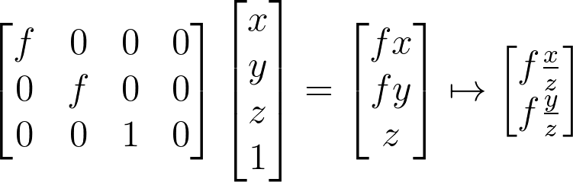
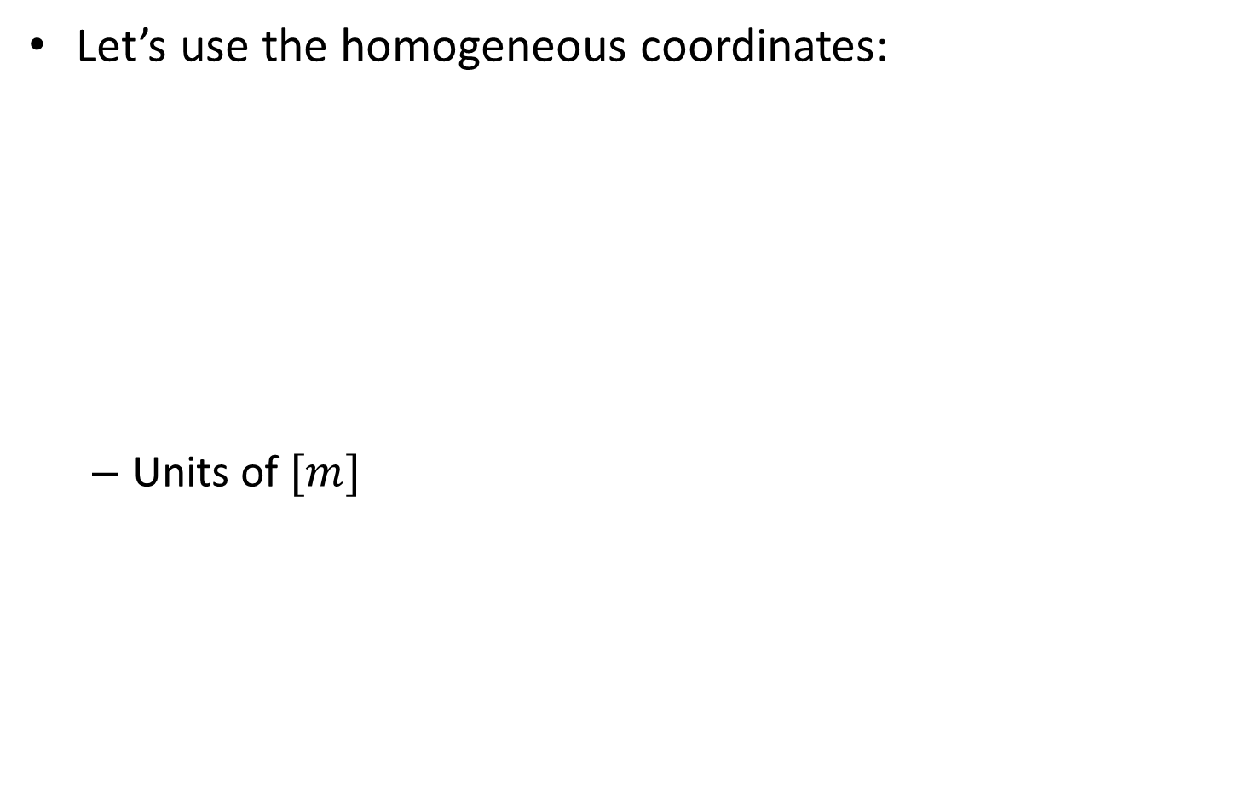
Perspective projection
Let’s use the homogeneous coordinates:
Units of $[m]$
Notes:
\begin{bmatrix}f & 0&0&0
\\ 0&f &0&0
\\0&0&1&0
\end{bmatrix}
\begin{bmatrix}x
\\ y
\\z
\\1
\end{bmatrix}
=
\begin{bmatrix}fx
\\ fy
\\z
\end{bmatrix}
\mapsto
\begin{bmatrix}f\frac{x}{z}
\\ f\frac{y}{z}
\end{bmatrix}

Slide 46

Perspective projection
Let’s split into 2 matrices and use 3D->2D homogenous coordinates:
Intrinsic camera matrix
Projection matrix
Notes:
\begin{bmatrix}f & 0&0
\\ 0&f &0
\\0&0&1
\end{bmatrix}
\begin{bmatrix}1 & 0&0&0
\\ 0&1 &0&0
\\0&0&1&0
\end{bmatrix}
\begin{bmatrix}x
\\ y
\\z
\\1
\end{bmatrix}
=
\begin{bmatrix}fx
\\ fy
\\z
\end{bmatrix}
\mapsto
\begin{bmatrix}f\frac{x}{z}
\\ f\frac{y}{z}
\end{bmatrix}

Slide 47
Vertigo effect
Has several different names (vertigo effect, dolly zoom, lens compression, perspective distortion) that all mean the same thing.
intro:
https://www.youtube.com/watch?v=UrhtKvBMZ3g (until 01:50)

Slide 48

Vertigo effect
https://www.youtube.com/watch?v=_TTXY1Se0eg(until 02:55)

Slide 49

Vertigo effect

Slide 50
contents
2D->2D transformations
3D->3D transformations
3D->2D transformations (3D projections)
Perspective projection
Orthographic projection

Slide 51
Orthographic projection
A different kind of camera model that can be used is orthographic projection or orthographic camera.
This kind of projection is invariant to the distance from the camera, and only depends on the object’s size.

Slide 52


Orthographic projection
image
world
Orthographic matrix
Weak perspective matrix (with scale coefficient)
Notes:
\begin{bmatrix}1 & 0&0&0
\\ 0&1 &0&0
\\0&0&0&1
\end{bmatrix}
\begin{bmatrix}x
\\ y
\\z
\\1
\end{bmatrix}
=
\begin{bmatrix}x
\\ y
\\1
\end{bmatrix}
\mapsto
\begin{bmatrix}x
\\ y
\end{bmatrix}
=======================================
\begin{bmatrix}1 & 0&0&0
\\ 0&1 &0&0
\\0&0&0&z_0
\end{bmatrix}
\begin{bmatrix}x
\\ y
\\z
\\1
\end{bmatrix}
=
\begin{bmatrix}x
\\ y
\\z_0
\end{bmatrix}
\mapsto
\begin{bmatrix}x/z_0
\\ y/z_0
\end{bmatrix}

Slide 53
Orthographic projection
When can we assume a weak perspective camera?

Slide 54



Orthographic projection
When can we assume a weak perspective camera?
When dealing with a plane parallel to image plane- $z_{0}$ is the distance to this plane.
When far away objects- we can assume the average distance to the objects as $z_{0}.$

Slide 55

Weak perspective camera
One way to transform a regular perspective image to an orthographic view is simply taking the picture from a distance with zoom (large focal length).

Slide 56

Weak perspective camera
Real orthographic camera:
Place a pinhole at focal length, so that only rays parallel to primary ray pass through.
set the sensor distance as
$$D^{′}=2f$$
in order to achieve unit magnification.
object distance D
focal length f
sensor distance D’

Slide 57


Weak perspective camera
perspective camera
weak perspective camera

Slide 58
Orthographic projection
Why we want to assume a weak perspective camera?

Slide 59

Orthographic projection
Why we want to assume a weak perspective camera?
Easier to do a lot of image manipulation. For example: image stitching (no projective transformation, just affine), called panograma.

